Slide 1
To Do List
By
Sathya Narayanan

Slide 2
Benefit of the project
To Increases productivity
To Improves memory
To Reduces stress
Allows for more personal time
Reduces anxiety and improves mental health

Slide 3
Technology used
Back-end development - STS
Spring Boot
Core Java
MySQL
Front-end development – VS code
Angular
Bootstrap
CSS and HTML

Slide 4
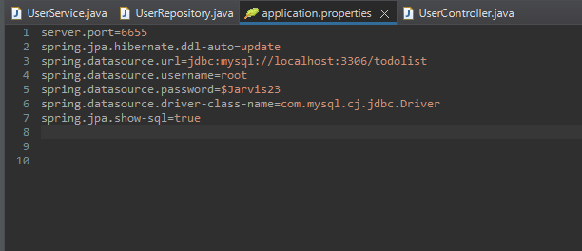
In Spring Boot
Application properties:
It is used to set configuration for the application

Slide 5
Annotations:
It allows us to configure dependencies and
implement dependency injection through java programs.
@Service, @Repository, @Controller, @Autowired , etc...

Slide 6
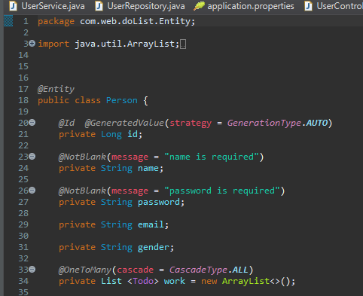
Entity:
The entities are the persistence objects stores as a record in the database.
Annotated by @Entity

Slide 7
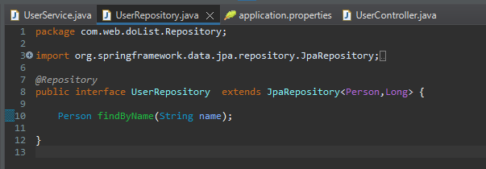
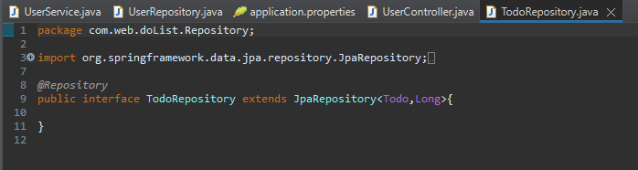
JPA Repository:
It is mainly used for managing the data in a Spring Boot Application by CRUD operations.
That class annotated by @Repository

Slide 8
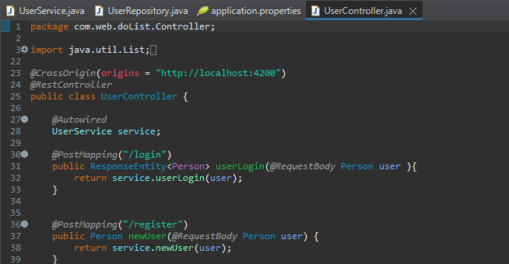
RestController:
Rest Controller is used for making restful web services with the help of the @RestController annotation.

Slide 9
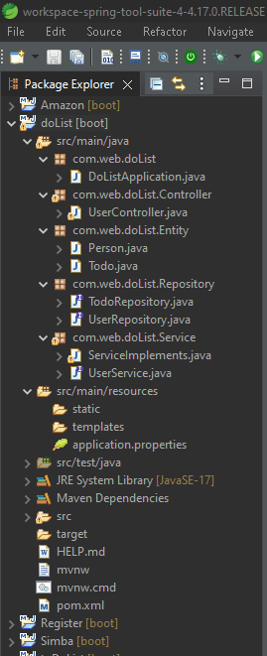
Spring Boot

Slide 10
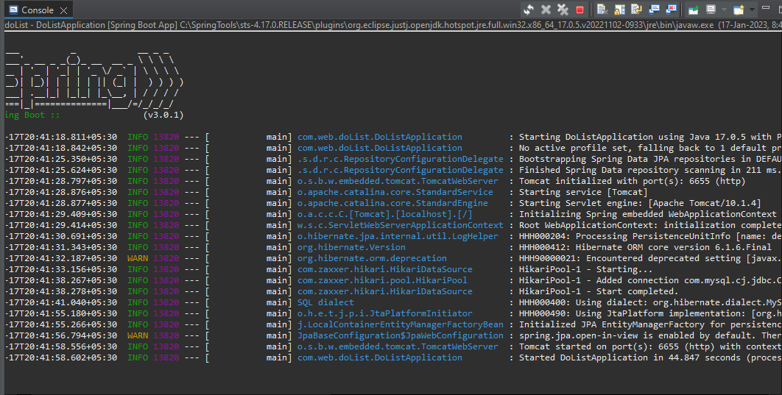
Backend running status

Slide 11
MySQL (RDBMS)
MySQL creates a database for storing and manipulating data, defining the relationship of each table.
Database name = dolist;
Tables names = person,todo;

Slide 12
ANGULAR
Angular is a platform and framework for building single-page client applications using HTML and Typescript.

Slide 13
Components:
Components are the most basic UI building block of an Angular app. An Angular app contains a tree of Angular components
Components contains typescript, Html and CSS files.
Components name = Login , Register, To-do-list.

Slide 14
Classes :
A class is a blueprint for creating an object like entity class in spring boot.
The Class names are :
Person
Todo
Services:
A service is anything that an application needs to complete a certain task or to carry out an operation
Service name = userService.service

Slide 15
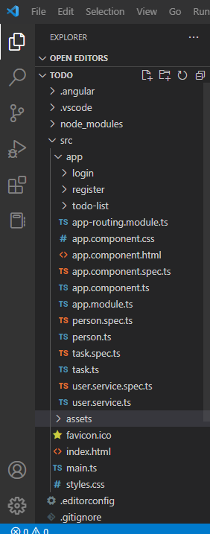
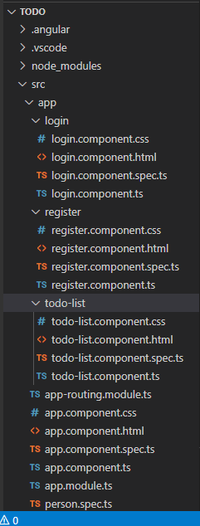
Angular

Slide 16
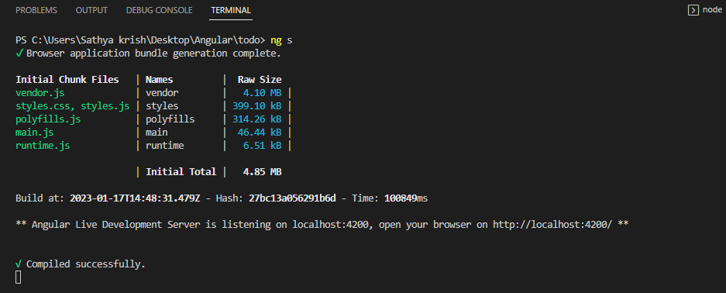
Front end running status

Slide 17
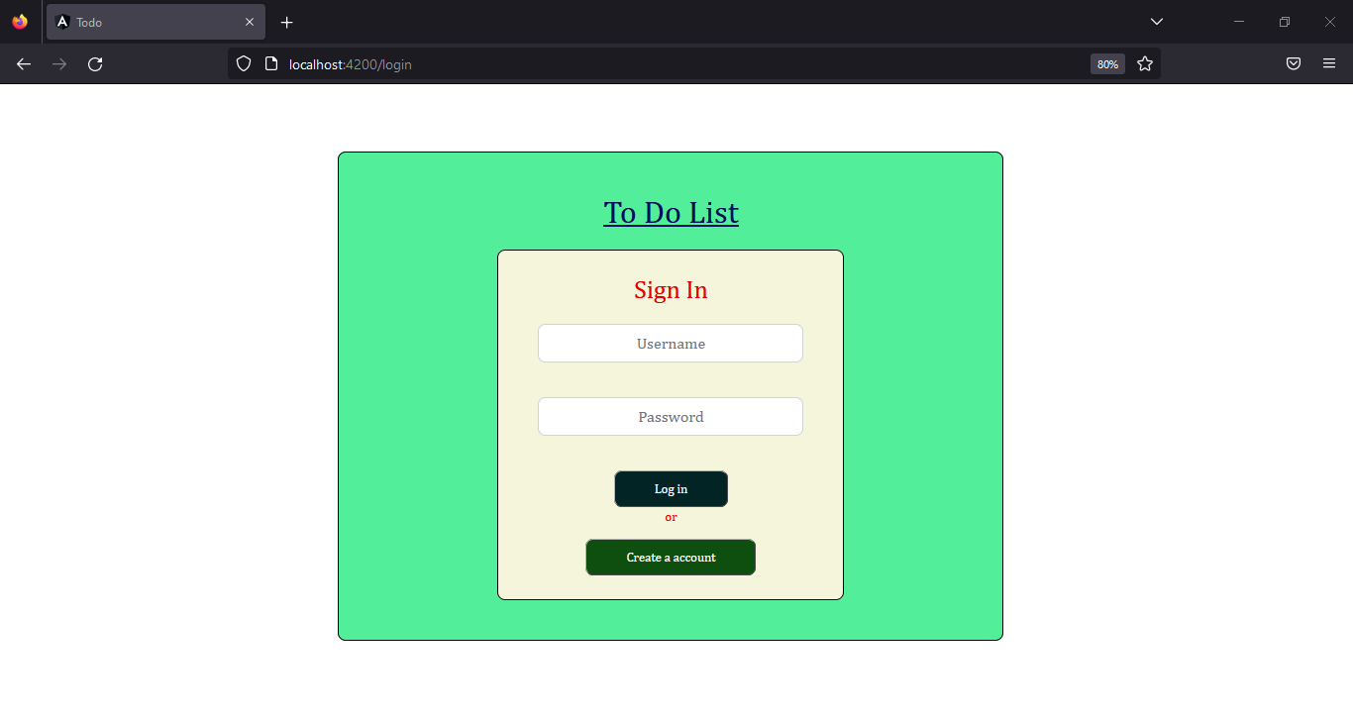
LOGIN PAGE

Slide 18
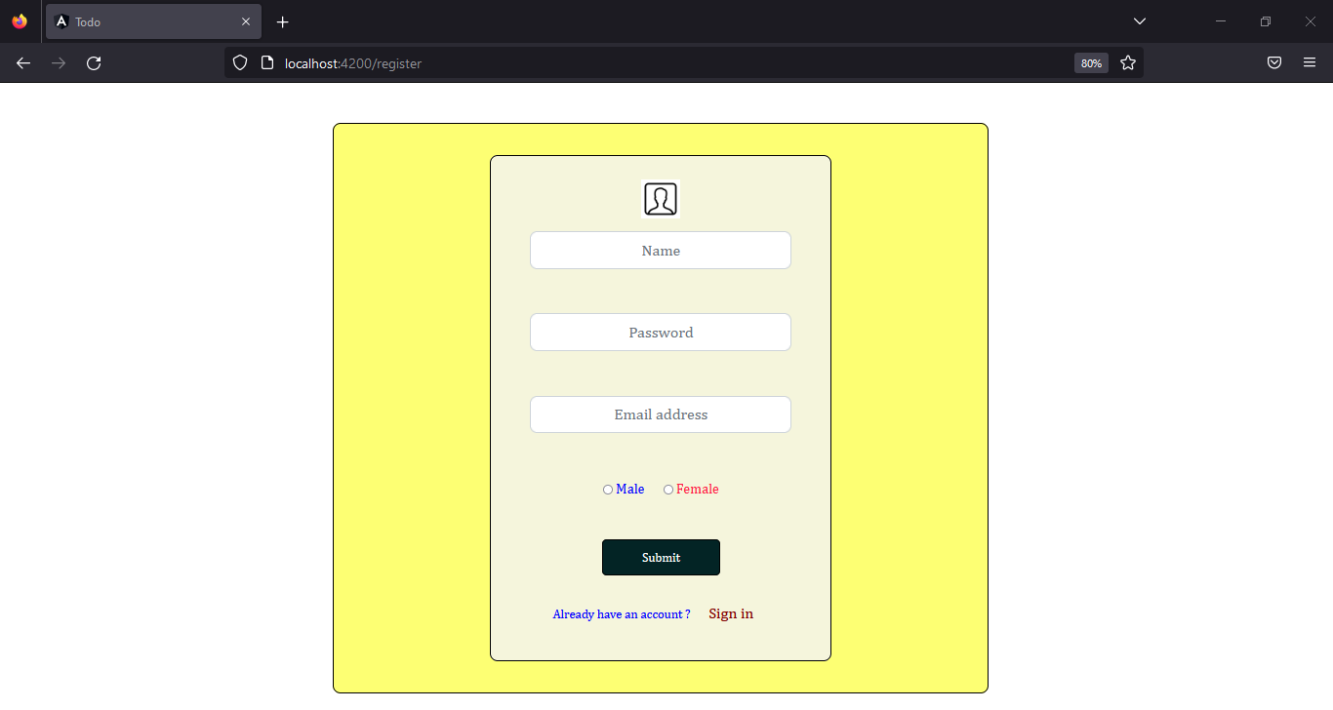
REGISTER PAGE

Slide 19
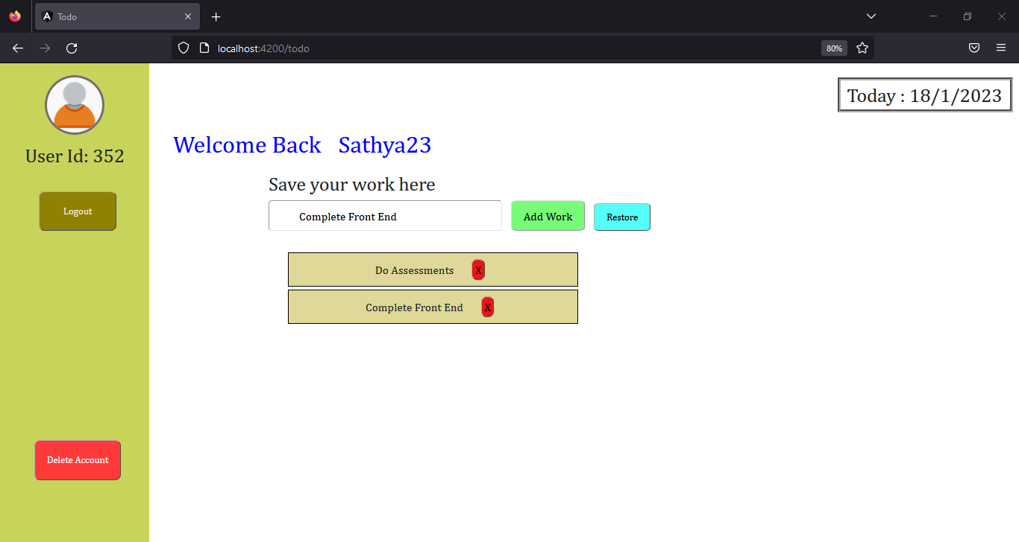
MAIN PAGE

Slide 20
Thank you !!

